Slide 1
Fundamental Network Programming
Async programming in Socket C#
Lecturer: MSc. Dang Le Bao Chuong
Spring 2022

Slide 2
Agenda
Asynchronous programming
Async programming
Socket Async in C#

Slide 3
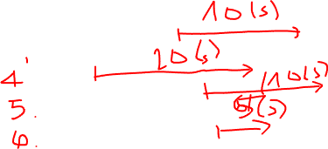
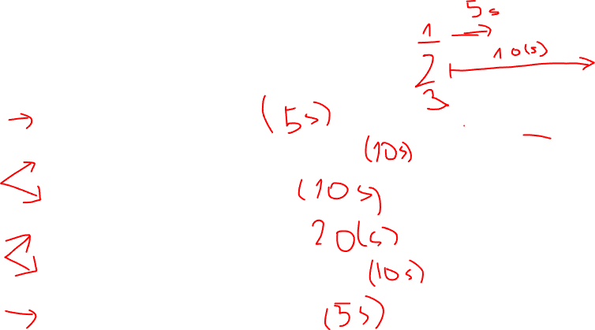
Making breakfast example
Pour a cup of coffee.
Heat up a pan, then fry two eggs.
Fry three slices of bacon.
Toast two pieces of bread.
Add butter and jam to the toast.
Pour a glass of orange juice.
If you’re the one who make a breakfast with these tasks, how will you execute the tasks to minimize the time ?
Cooking breakfast is a good example of asynchronous work that isn't parallel. Why ?
Notes:
ou'd start warming the pan for eggs, then start the bacon. You'd put the bread in the toaster, then start the eggs. At each step of the process, you'd start a task, then turn your attention to tasks that are ready for your attention.
Cooking breakfast is a good example of asynchronous work that isn't parallel

Slide 4
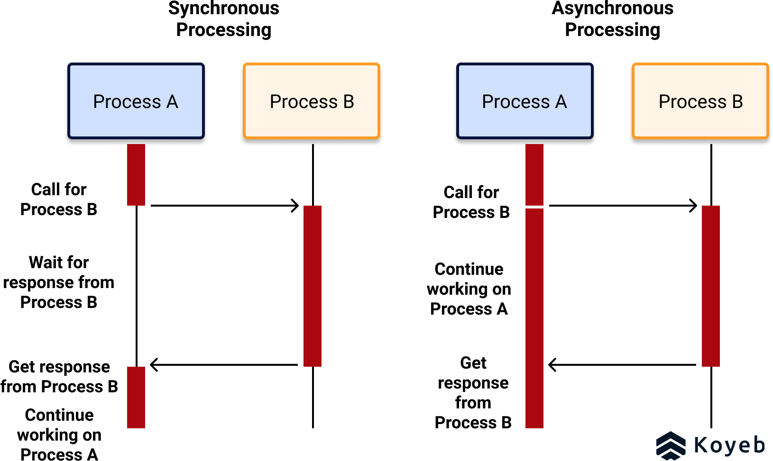
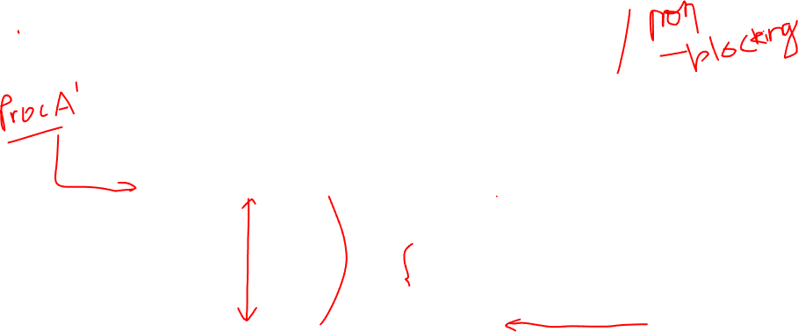
Or Thread
Or Thread
Or Thread
Or Thread

Slide 5
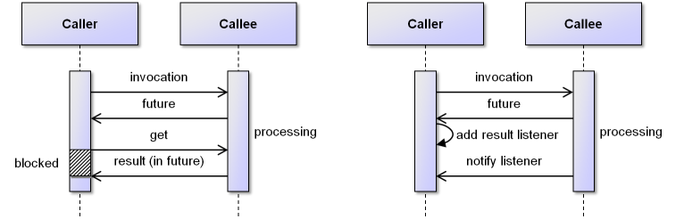
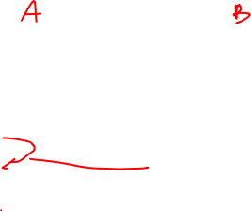
How to continue working and keep waiting for result

Slide 6
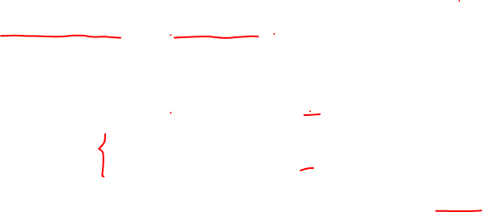
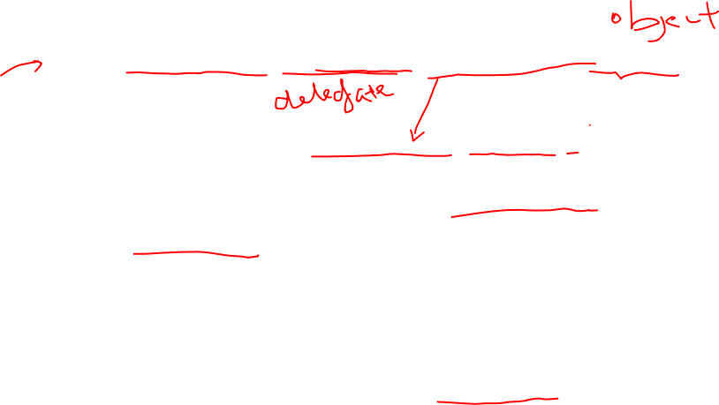
Perform asynchronous in C# Socket
tcpListener.BeginAcceptTcpClient(new AsyncCallback(OnAcceptedTcpClient), tcpListener);
private void OnAcceptedTcpClient(IAsyncResult ar)
{
TcpListener listener = (TcpListener)ar.AsyncState;
TcpClient client = listener.EndAcceptTcpClient(ar);
}
Accepting new connection
tcpListener.BeginAcceptSocket(new AsyncCallback(OnAcceptedSocket), tcpListener);
private void OnAcceptedSocket(IAsyncResult ar)
{
TcpListener listener = (TcpListener)ar.AsyncState;
Socket client = listener.EndAcceptSocket(ar);
}
Accepting new connection

Slide 7
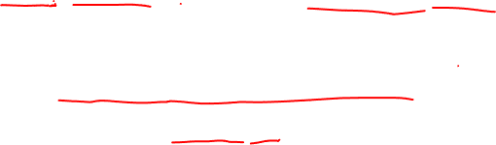
Perform asynchronous in C# Socket
socket.BeginReceive(buffer, 0, buffer.Length, SocketFlags.None, OnClientReceive, stateObj)
private void OnClientReceive(IAsyncResult ar)
{
object stateObj = ar.AsyncState;
// Can pass anything useful as stateObj
nBytesRec = clientSocket.EndReceive(ar)
// Call BeginReceive again to continue reading from network
socket.BeginReceive(..)
}
Reading from network

Slide 8
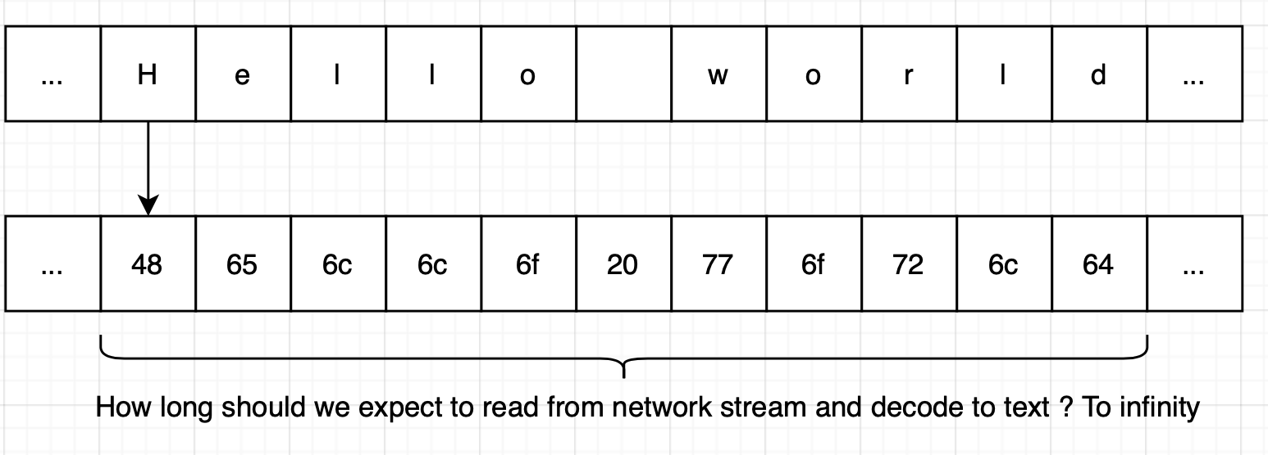

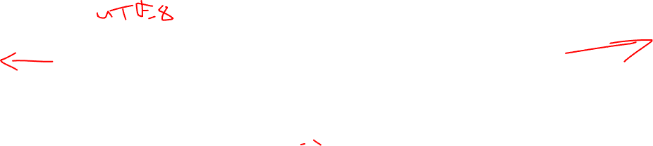
Design the packet structure

Slide 9
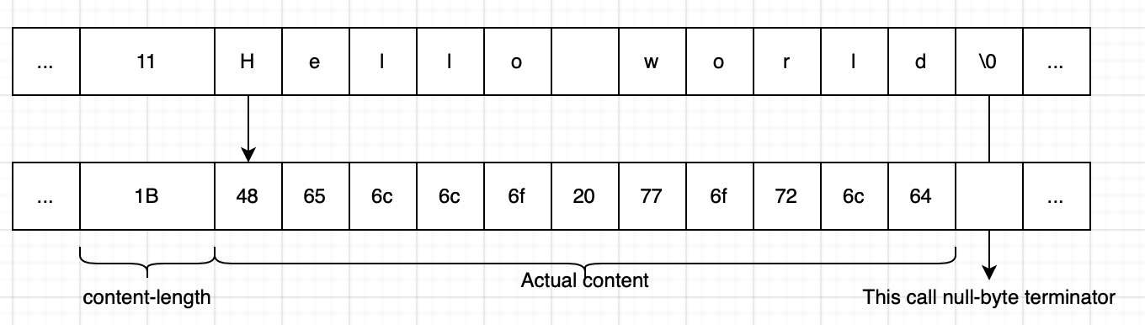
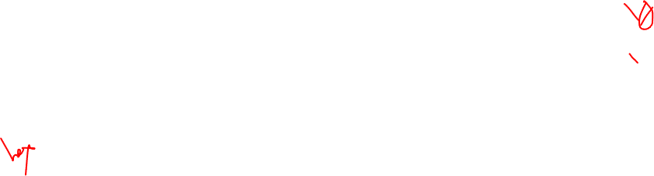
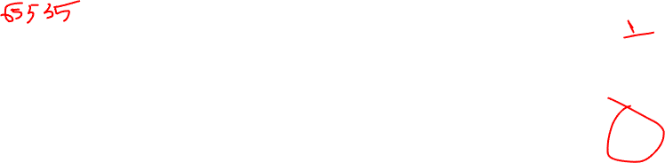
Design the packet structure – length field
What if those bytes aren't meant for text

Slide 10
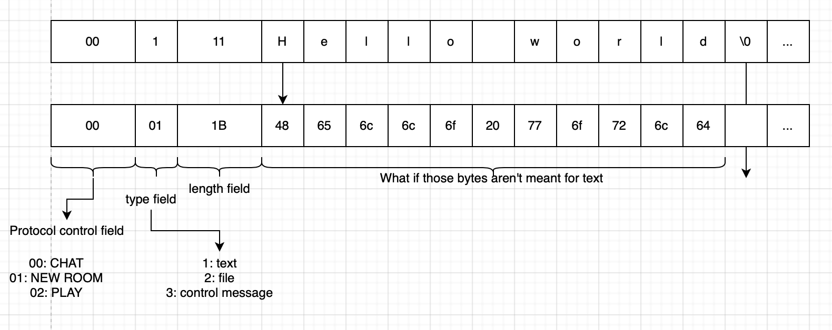
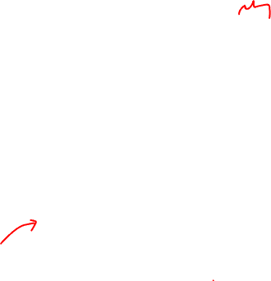

Design the packet structure – other header fields

Slide 11
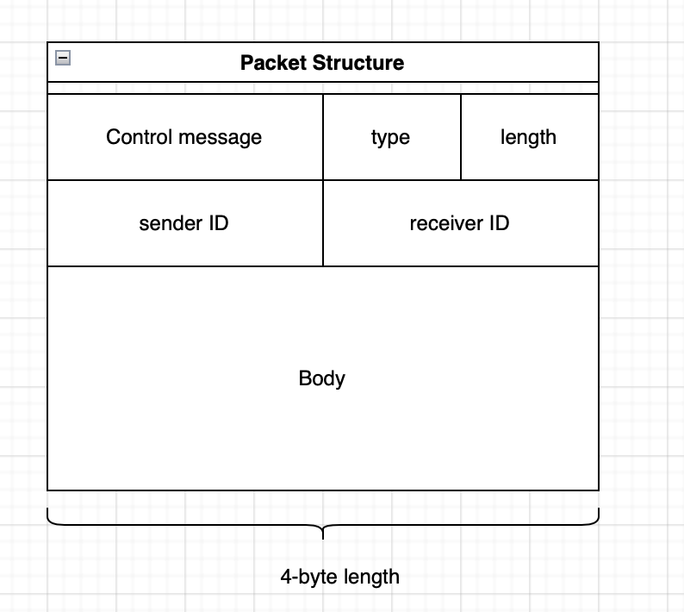

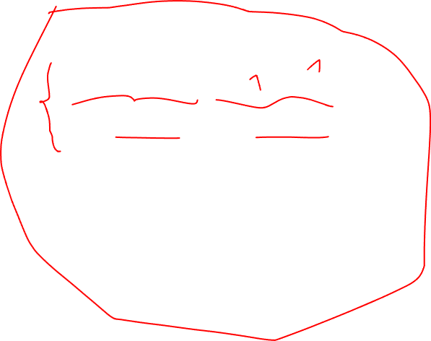
Design the packet structure – other header fields

Slide 12
References
https://docs.microsoft.com/en-us/dotnet/csharp/programming-guide/concepts/async/
https://docs.microsoft.com/en-us/dotnet/framework/network-programming/using-an-asynchronous-server-socket

Slide 13
Assignment week #7
Tcp Chat Server using asynchrous programing for both client and server side
Use your own code from week #5 to develop further

